Slide 1
Raven Teleoperation - Automove
Yun Hsuan Su (Melody)

Slide 2
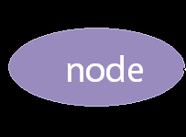

ROS Node
ROS Nodes are processes that perform computation.
Each node is in charge of a different task.
Multiple nodes may cooperate to accomplish on bigger tasks.
Notes:
The idea of ROS is based on the interaction of ROS nodes.
Which are modules of processes or codes that perform computation.

Slide 3
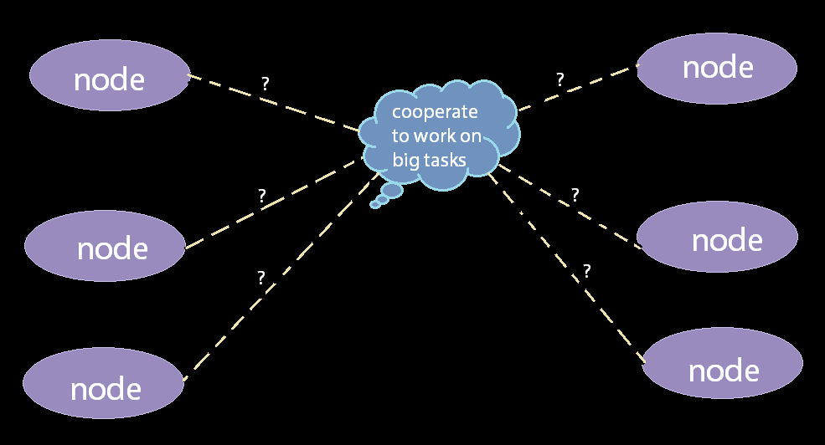
ROS Communication
Notes:
But how do they communicate with each other?

Slide 4
ROS Communication
ROS Topic:
Based on a subscribe/publish system.
Many-to-many communication.
Data is exchanged asynchronously.
Agree on a paragraph structure – message,
which is saved in the “.msg” file.
Where: package_name/msg/myMessageType.msg
ROS Service:
Based on a request/response system.
Message bus between two nodes.
Data is exchanged synchronously in pairs. When a node sends out a request, it awaits a response.
The “.srv” file describes the data structures for requests and responses
Where:
package_name/srv/myServiceType.srv
Notes:
the type of data published (the message) is always structured in the same way.
Nodes that subscribe/publish to the same topic
send and receive messages with the same structure.
A topic is an asynchronous communication method used for many-to-many communication.
A service meets a different kind of need; that for synchronous communication between two nodes.

Slide 5
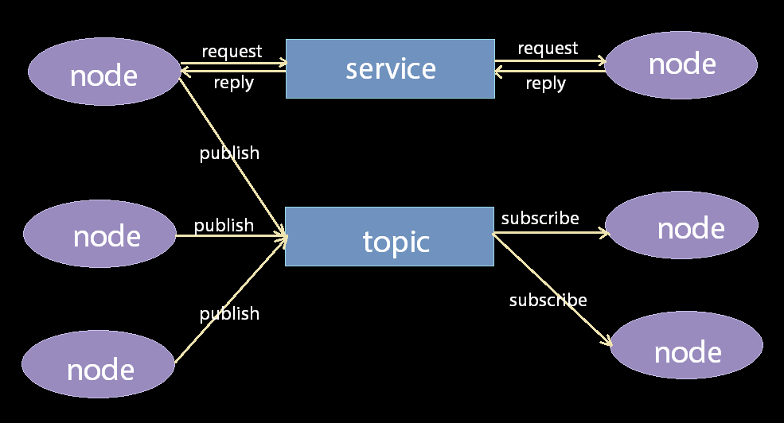
ROS Communication
In Raven teleoperation, we use ROS Topic.
(1) For long term stability.
(2) Make sure always taking the most recent information. (command)
Notes:
We can bear with dropping or missing one or two
Guarantees that the system to be constantly running

Slide 6
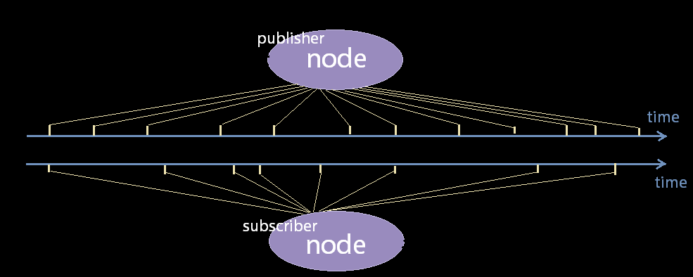
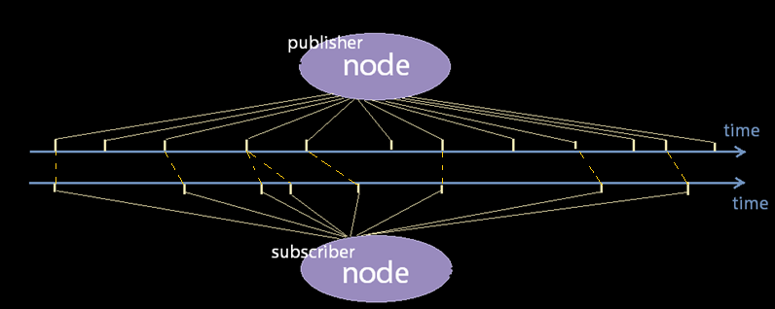
ROS Topic
In Raven teleoperation, we use ROS Topic.
(1) For long term stability.
(2) Make sure always taking the most recent information. (command)
Publisher node: update whenever you want.
Subscriber node: retrieve the message when needed, so it will always obtain the most current updated version.
Notes:
We can bear with dropping or missing one or two.
But we don’t want the entire system to stop and just wait for one message update response.

Slide 7
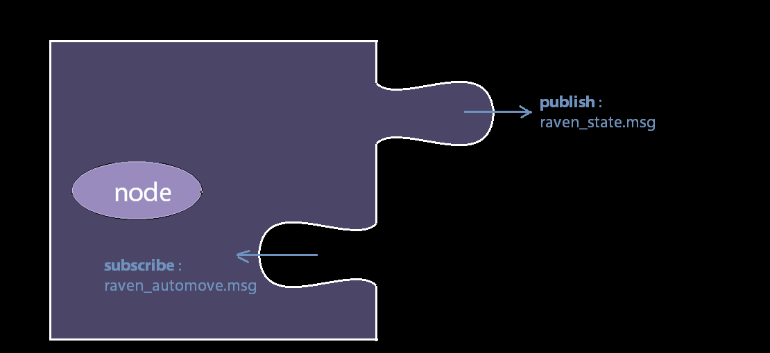
ROS Topics in Raven
In Raven teleoperation, we use ROS Topics.
There are 2 topics in the raven code:
(2) subscribe to: raven_automove
Receives raven remote control command. These commends are incremental commands of the robot tip position and orientation.
(1) publish to: raven_state
updates Raven state, including joint angles, robot position and orientation, joint angles… etc. (AND jacobian force in Kinetic release!!! ☺)
https://github.com/uw-biorobotics/raven2/tree/kinetic/msg
Notes:
In respect to current state, not the absolute position/orientation control.

Slide 8
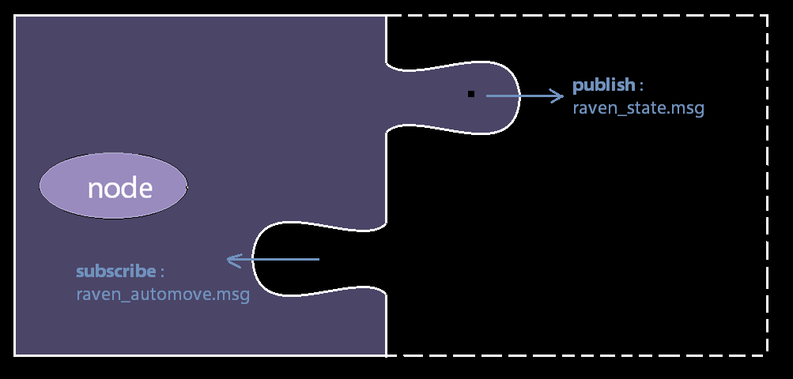
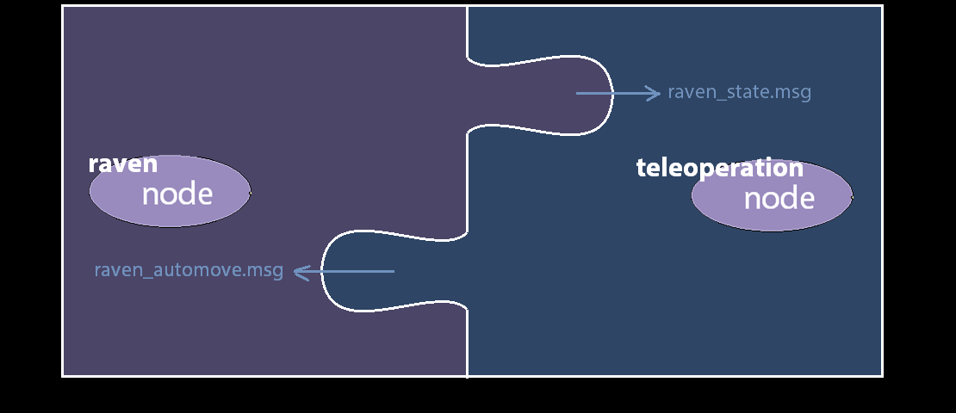
ROS Topics in Raven
Raven has 2 topics:
(1) publish to: raven_state
(2) subscribe to: raven_automove
How to interact with Raven?
(1) subscribe to: raven_state
(2) publish to: raven_automove
https://github.com/uw-biorobotics/raven2/tree/kinetic/msg
Notes:
Kind of need to construct this half of the puzzle
to interact with the raven ROS topics

Slide 9
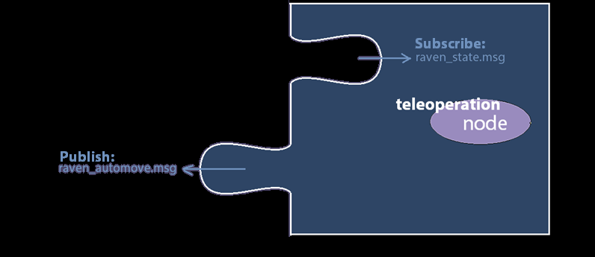
Teleoperation ROS Node for Raven
Construct a teleoperation ROS node.
(1) subscribe to: raven_state
(2) publish to: raven_automove
Notes:
Have a sense of the current Raven robot pose,
And you want to design commend accordingly,
Then save it to raven_automove ROS topic

Slide 10
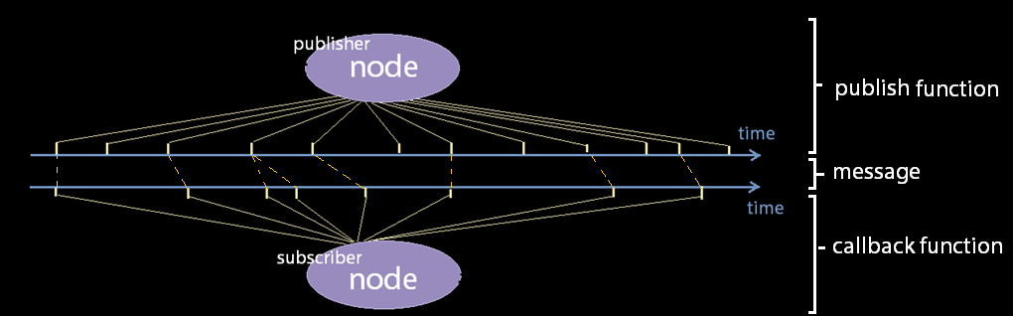
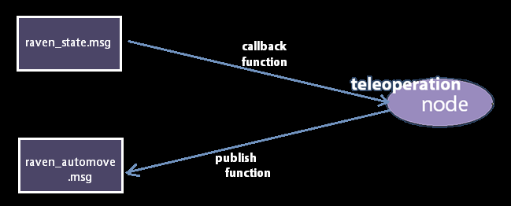
Teleoperation ROS Node for Raven
Notes:
In order for a node to be able to publish something,
And subscribe to something, we need the three components.

Slide 11
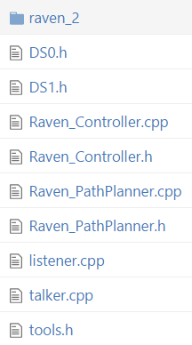
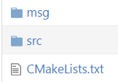
Teleoperation ROS Node for Raven
1. message:
Add the message files to the msg folder
Add the .h files to some directory under src folder
Include them in your code:
# include “raven_2/raven_automove.h”
#include “raven_2/raven_state.h”
Notes:
Another way is to clone the entire raven code down,
and include the .h file directly from the raven code.
This is to make your code cleaner

Slide 12
Teleoperation ROS Node for Raven
Declare publish/subscribe relation.
1. message:
Initialize the publish/subscribe relation
ros::init(argc, argv, "AutoCircle_generator");
static ros::NodeHandle n;
RavenAutomove_publisher = n.advertise<raven_automove>("raven_automove", 1);
RavenState_subscriber = n.subscribe("ravenstate",1,&Raven_Controller::callback_raven_state,this);
Topic names
The max number of messages it buffers up before beginning to throw away old ones.
Callback function name.
This part of code can be found in this link:
Raven_Controller.cpp → “init_ros” function
Notes:
buffer up a maximum of 1000 messages before beginning to throw away old ones.

Slide 13
Teleoperation ROS Node for Raven
How do you know what items
are in the message?
The .msg file has all the information.
Initialize the publish/subscribe relation
ros::init(argc, argv, "AutoCircle_generator");
static ros::NodeHandle n;
RavenAutomove_publisher = n.advertise<raven_automove>("raven_automove", 1);
RavenState_subscriber = n.subscribe("ravenstate",1,&Raven_Controller::callback_raven_state,this);
2. callback function:
Define the callback function.
void Raven_Controller::callback_raven_state(raven_2::raven_state msg) {
x = msg.pos[0]; // Get access to the items in the msg directly by name
y = msg.pos[1];
// then you can do something with x,y. }
Callback function name.
This part of code can be found in this link:
Raven_Controller.cpp → “callback_raven_state” function

Slide 14
Teleoperation ROS Node for Raven
2. callback function:
Define the callback function.
No need to call the callback function manually.
It will call itself, once there is an update to the ROS topic.

Slide 15
Teleoperation ROS Node for Raven
Wrap your command into message format:
Again, .msg file has all the information about items in the message structure.
3. publish function:
Define the publish function.
void Raven_Controller::publish_raven_automove() {
static raven_automove msg_raven_automove;
msg_raven_automove.hdr.stamp = msg_raven_automove.hdr.stamp.now();
tf::transformTFToMsg(TF_INCR[LEFT_ARM], msg_raven_automove.tf_incr[LEFT_ARM]); //tf_incr
RavenAutomove_publisher.publish(msg_raven_automove);
ros::spinOnce();}
Create a message object.
Like a postal stamp with current system time.
Special function to transform TF object to message item.
Trigger the publisher and subscriber node to update.
This part of code can be found in this link:
Raven_Controller.cpp → “publish_raven_state” function

Slide 16
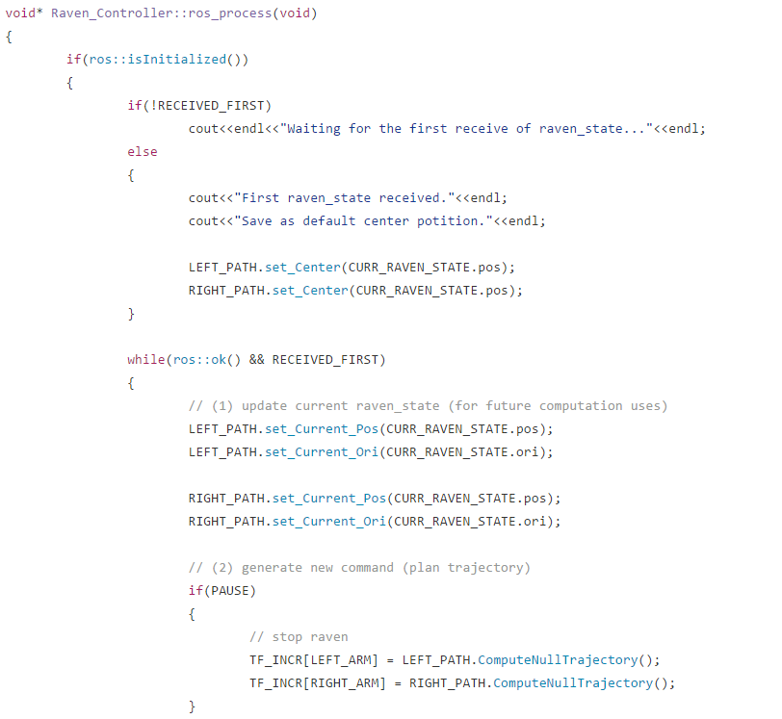
Teleoperation ROS Node for Raven
3. publish function:
Define the publish function.
Do need to call the publish function manually.
This part of code can be found in this link:
Raven_Controller.cpp → “publish_raven_state” function
Notes:
Usually in a while loop…
thread

Slide 17
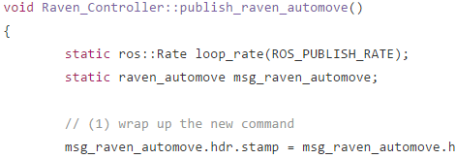
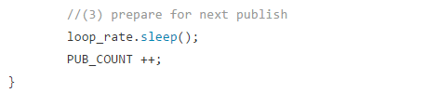
Teleoperation ROS Node for Raven
3. publish function:
Define the publish function.
Do need to call the publish function manually
Define publish rate!
ROS_PUBLISH_RATE = 1000 // in Hz.
An upper bound to the publish rate.
This part of code can be found in this link:
Raven_Controller.cpp → “publish_raven_state” function
Notes:
Upper bound because…
Accumulate the error of the desired pose to current pose,
DAC too high? Estop.
1 unit in z direction :n can’t keep up

Slide 18
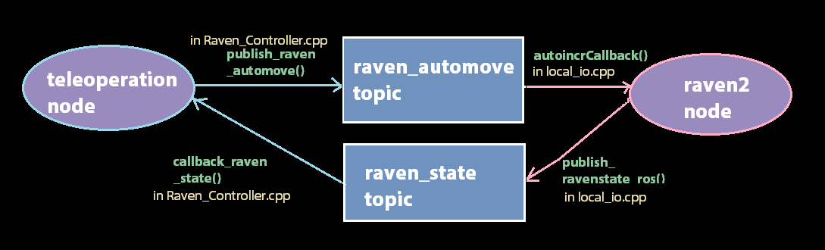
Raven Teleoperation Big Picture
1. message
2. callback function
3. publish function
Link
Link
Link to talker.cpp

Slide 19
Trouble shooting
1. How to create your own ROS topic:
Generate your own message instead of interacting with existing ones. Link
2. ROS topic publishing but the other side not receiving:
(1) Check if topic name or message content are different.
(2) Useful tool to check active ROS Topics: Link
rostopic info /topic_name
rostopic echo /topic_name -c
rostopic list

Slide 20
Trouble shooting
3. Working with multiple machines: Link(find the Trouble shooting section)
(1) Internet connection issue:
ping hostname_A
gedit /etc/hosts
(2) hostname settings:
// assume running on computer A
gedit ~/.bashrc // on computer A
ROS_MASTER_URL = host_A (or IP_A), ROS_IP = host_A (or IP_A)
gedit ~/.bashrc // on computer B
ROS_MASTER_URL = host_A (or IP_A), ROS_IP = host_B (or IP_B)

Slide 21
Reference Code
1. Simple Test Code Link (originated from Danying!)
2. AutoCircle Generater Code Link
3. Raven2 most recent release Code Link

Slide 22
Happy Thursday!
2016 . 12 . 01
Yun-Hsuan Su (Melody)

